Slide 1
Comparing model with simulation

Slide 2
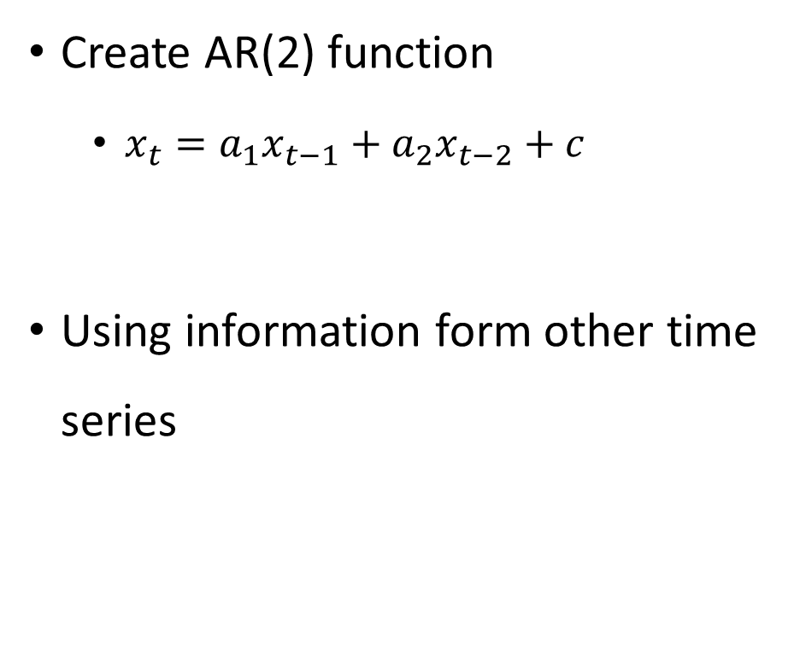
OLS regularization
Create AR(2) function
$x_{t}=a_{1}x_{t−1}+a_{2}x_{t−2}+c$
Using information form other time series
O(x):
O(y):

Slide 3
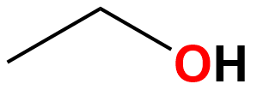
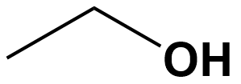
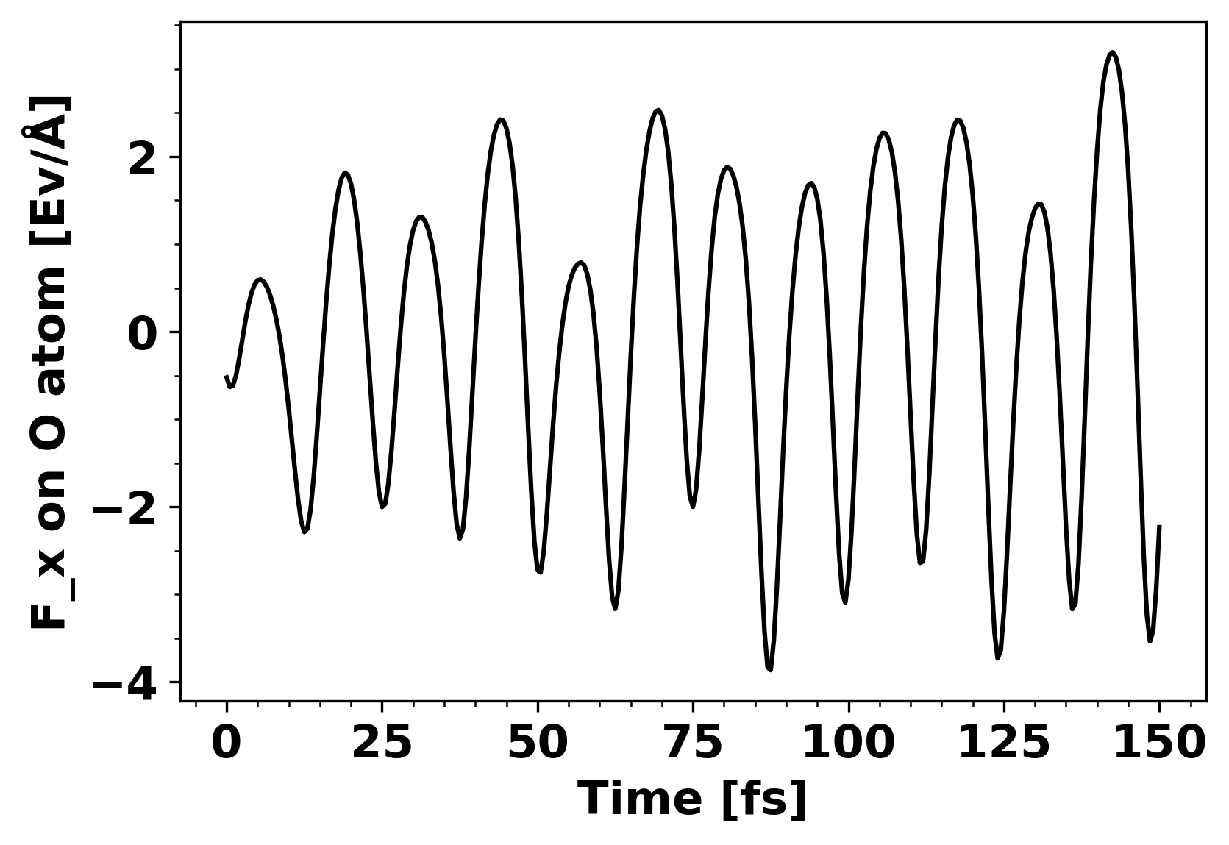
What have I done
Molecular simulation of ethanol
Velocity Verlet dynamics
Mode: LCAO
xc: PBE
Basis set: szp
dt: 0.5 fs
n_steps: 300

Slide 4
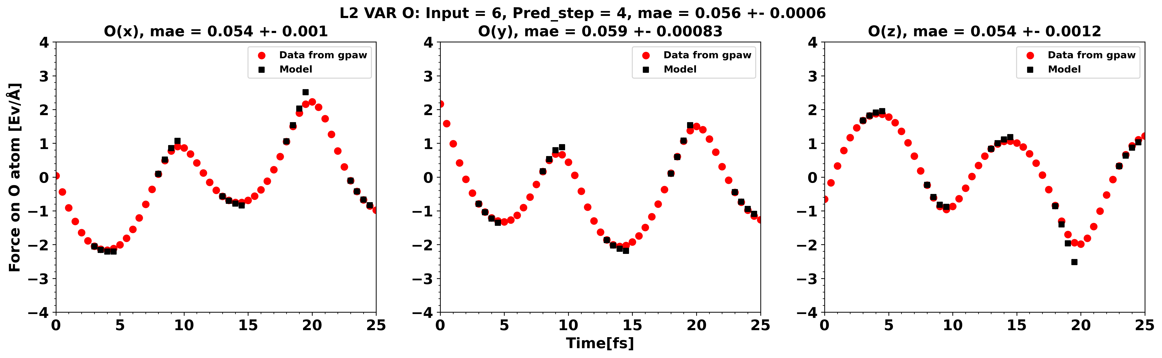
OLS VAR regularization

Slide 5
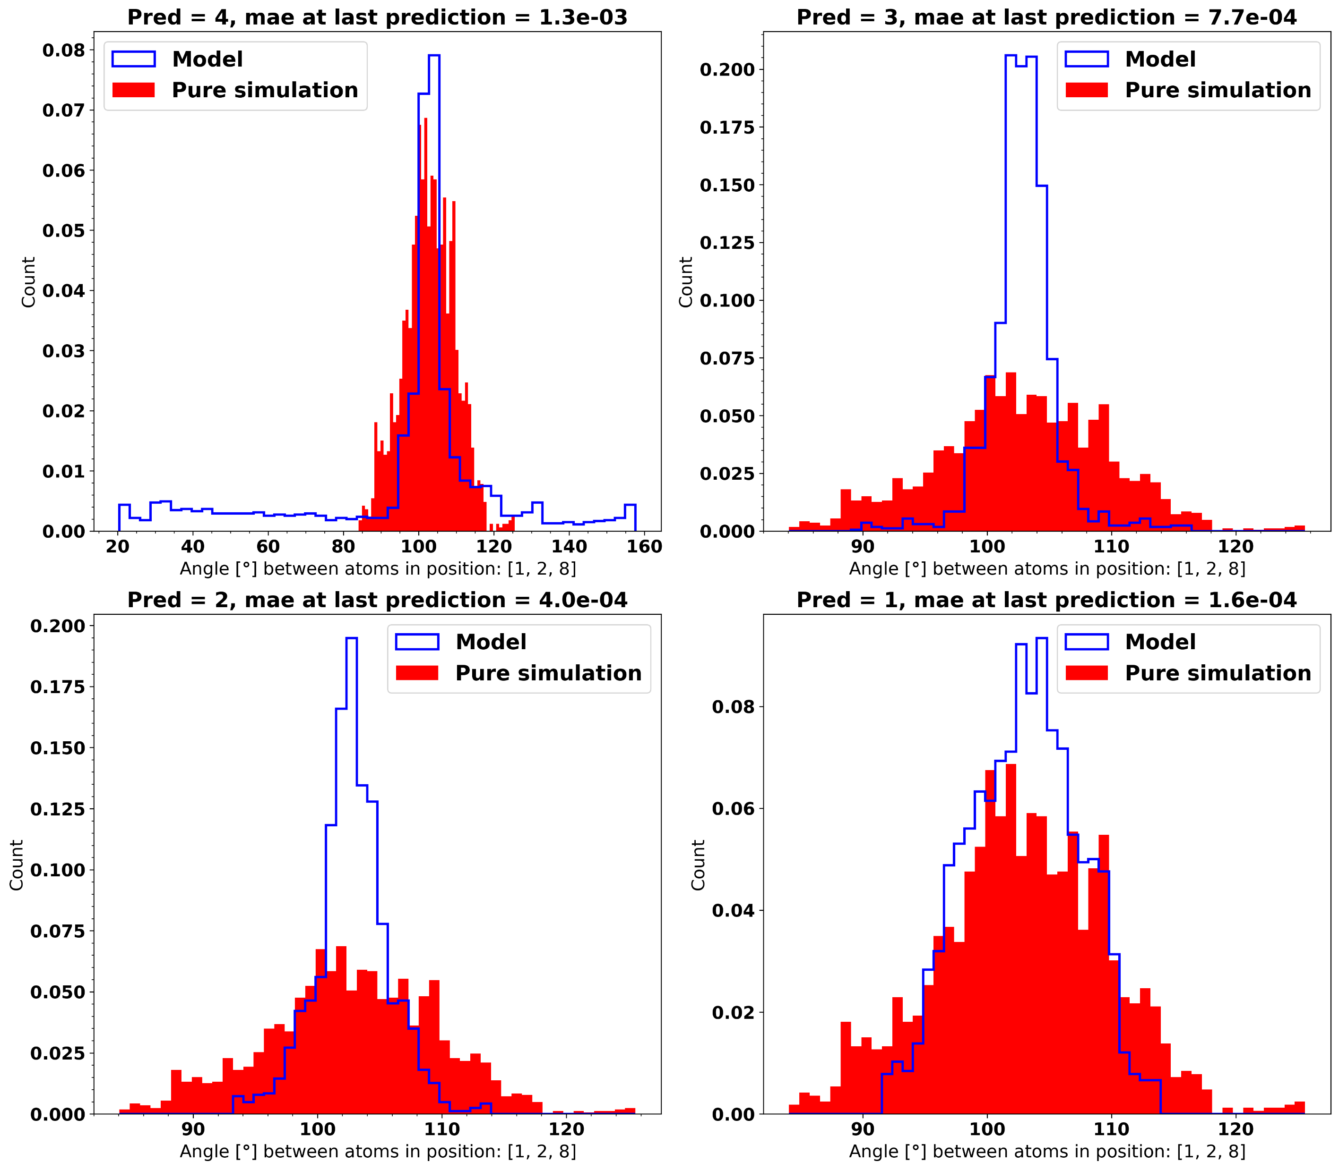
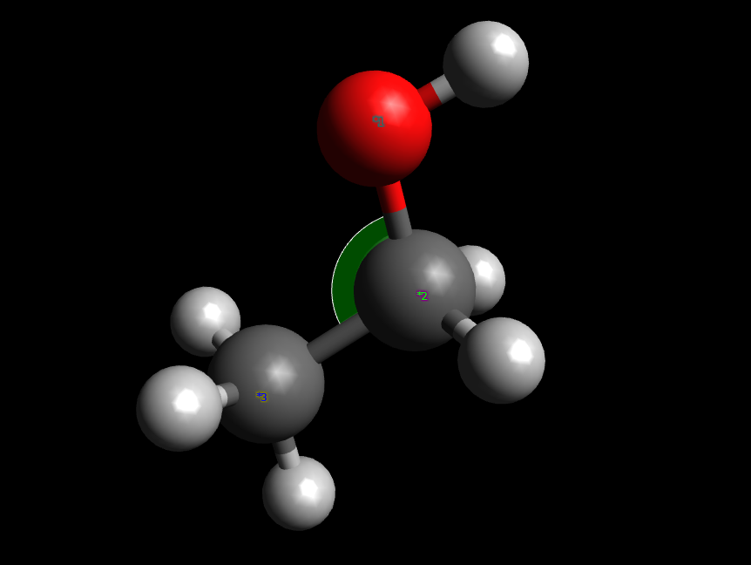
Distribution of angle

Slide 6
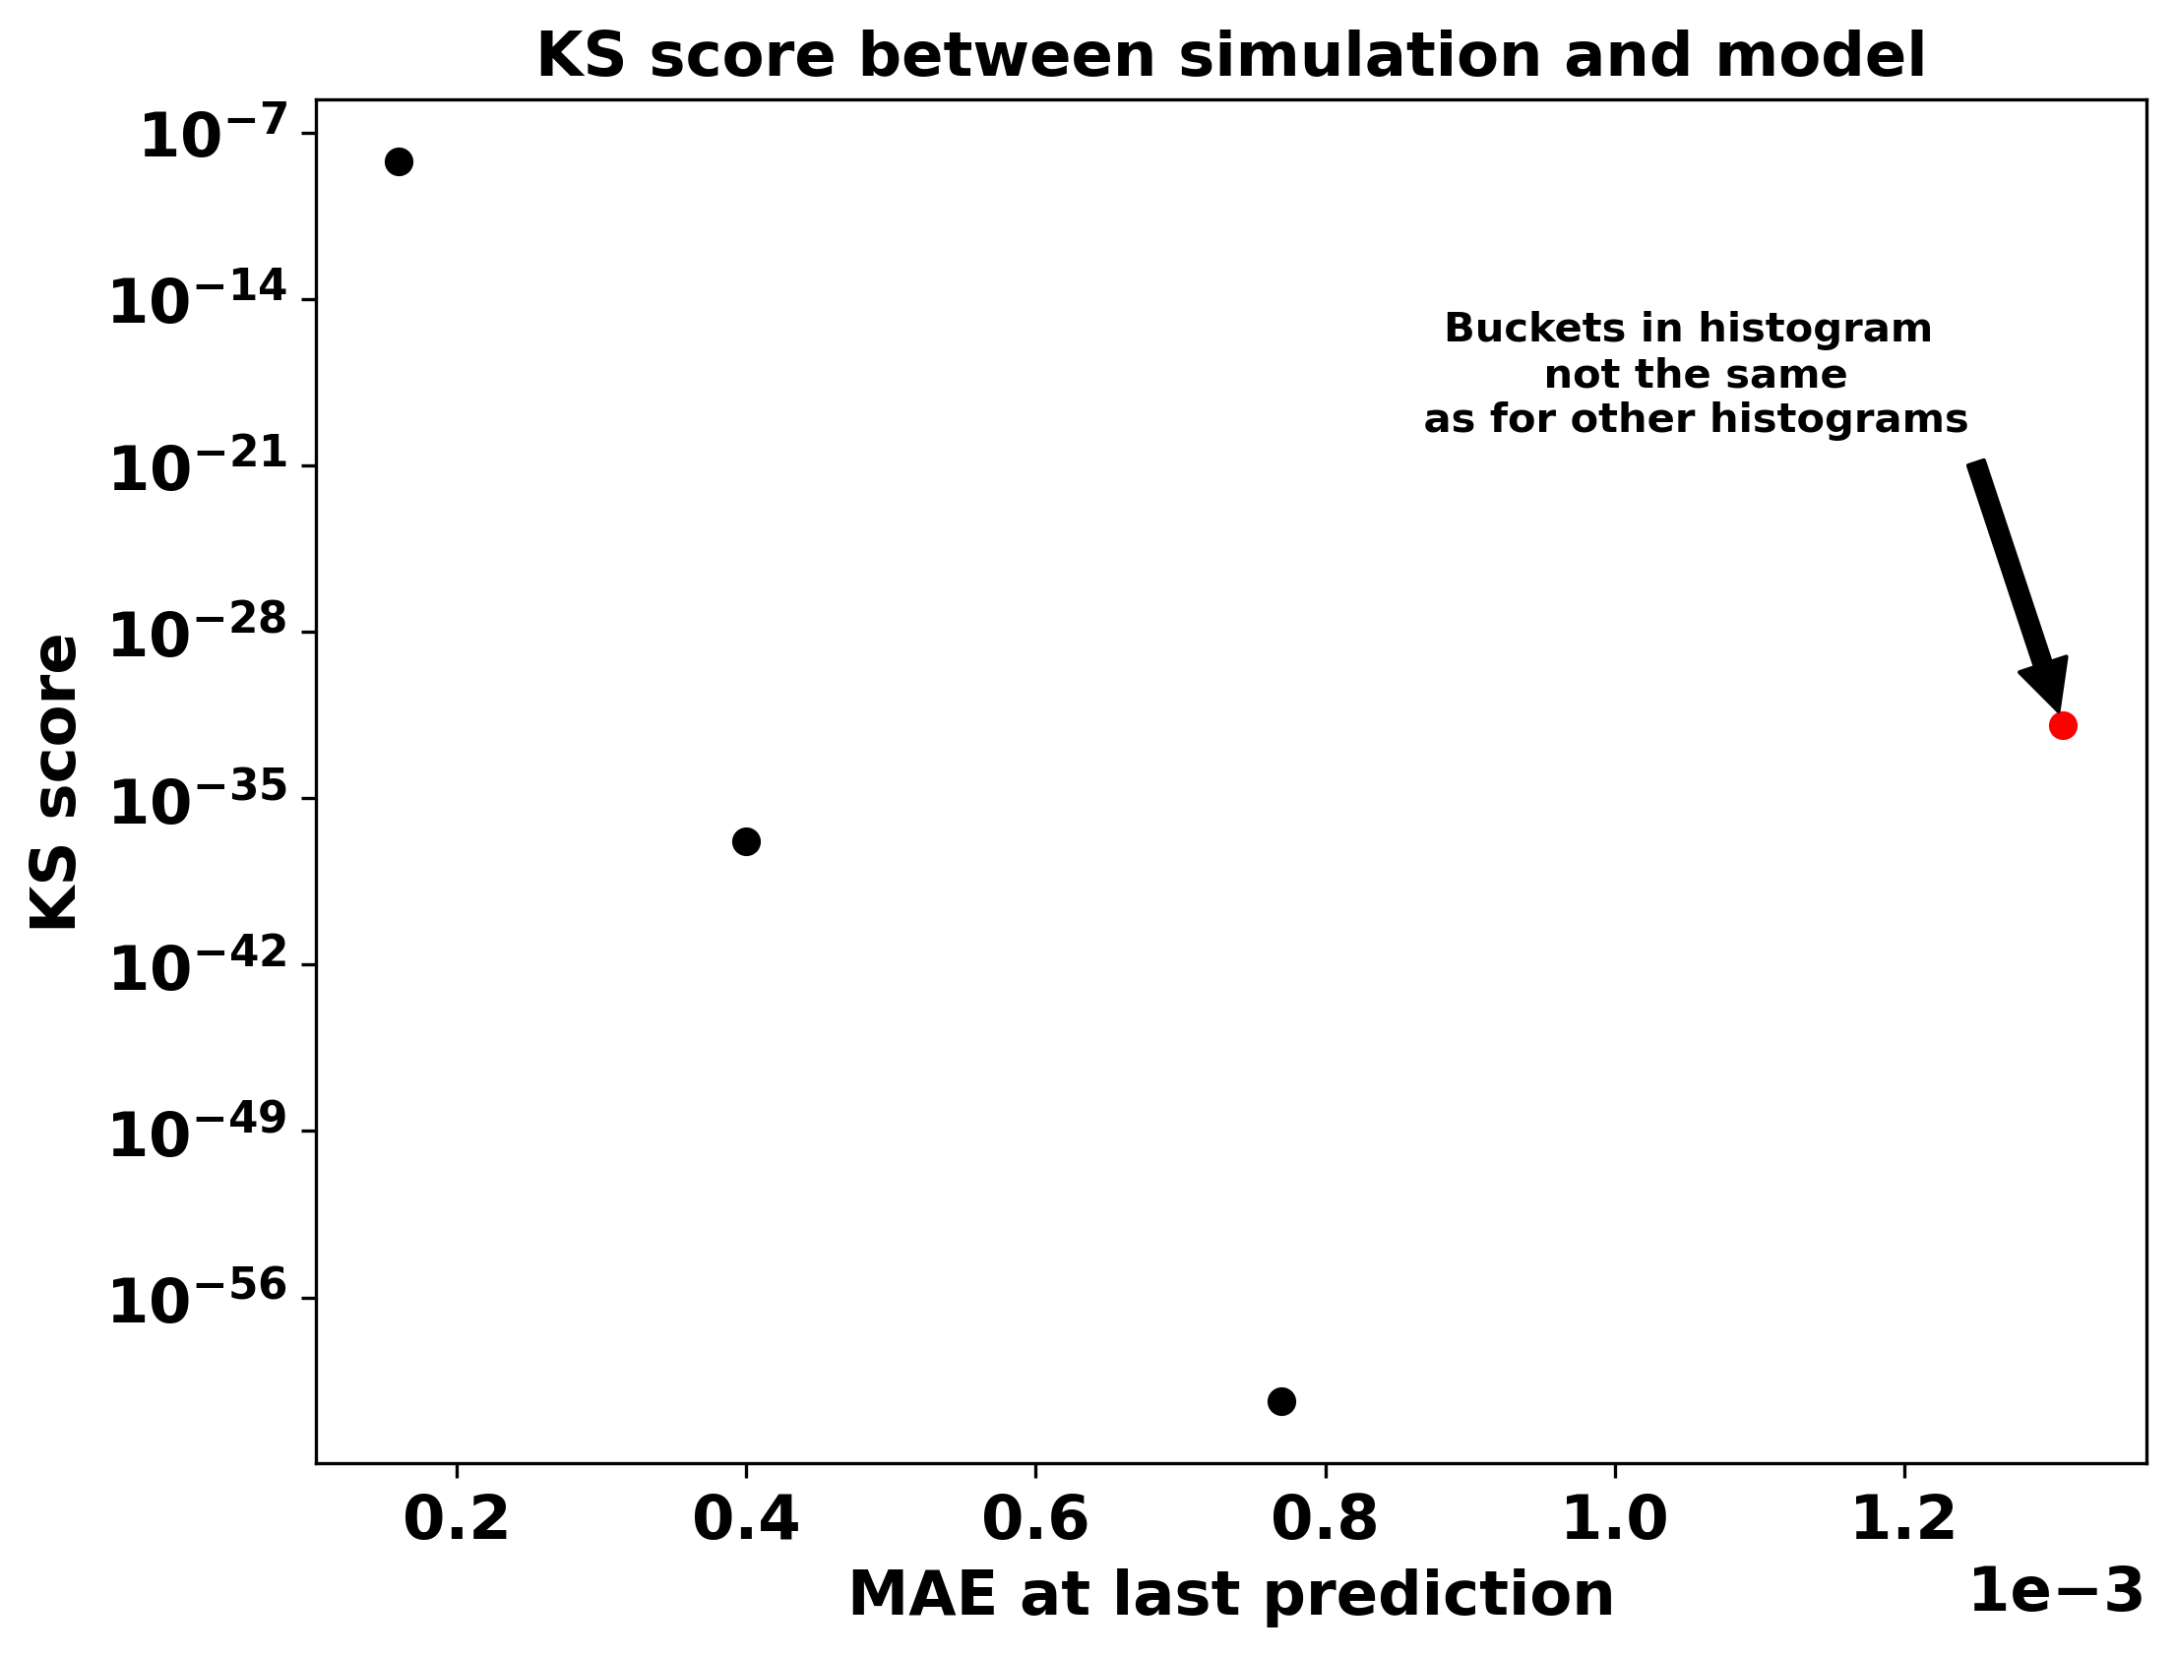
KS score of angle comparison

Slide 7
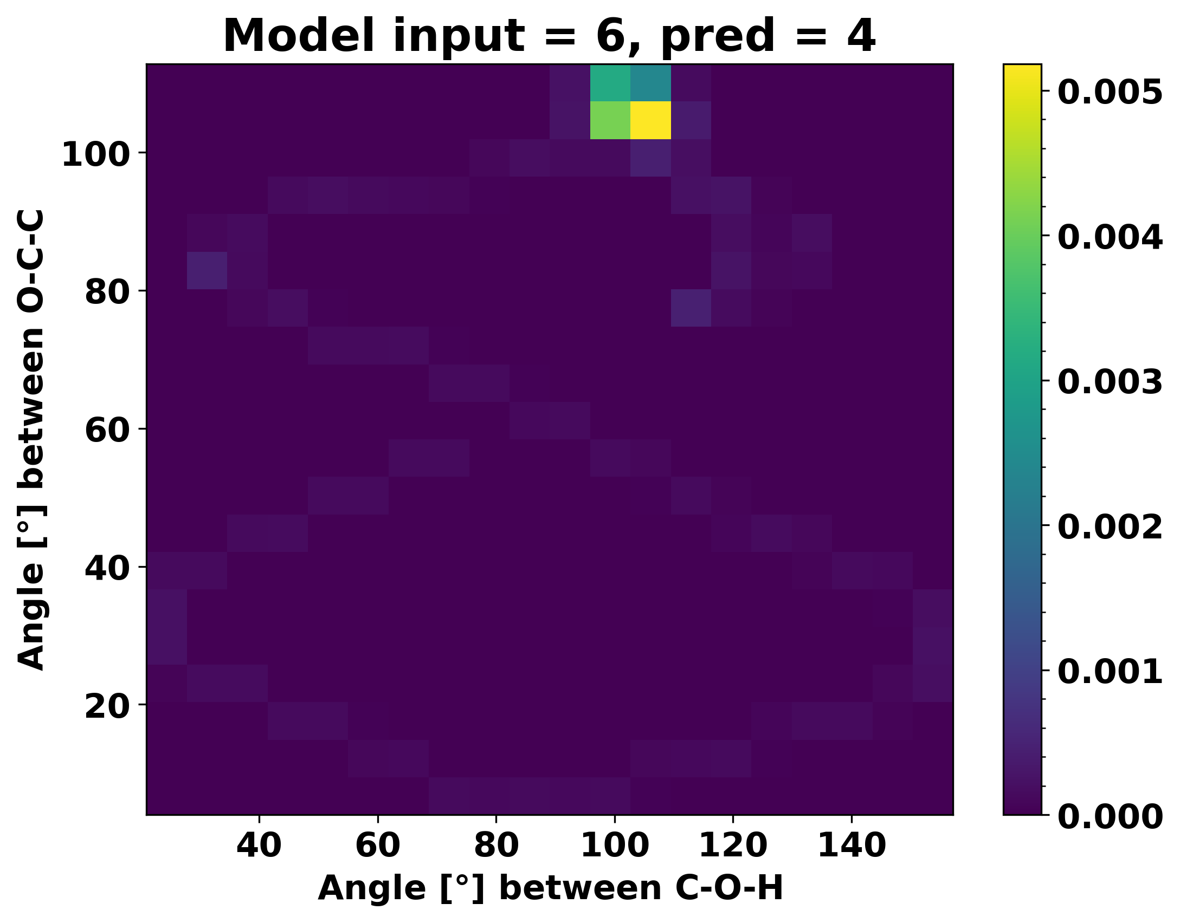
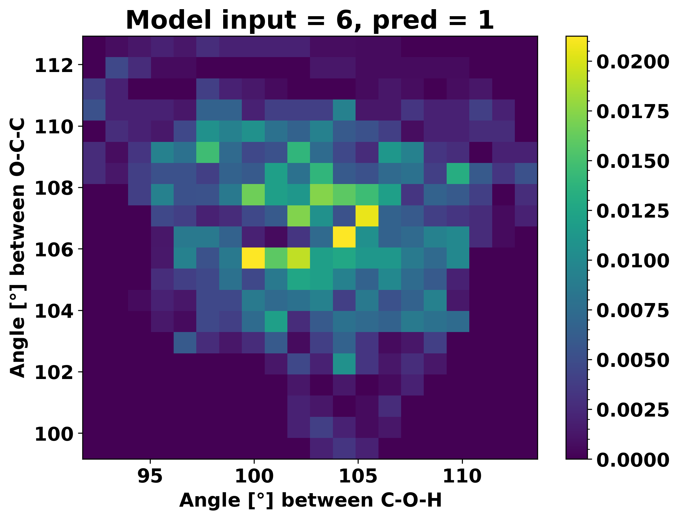
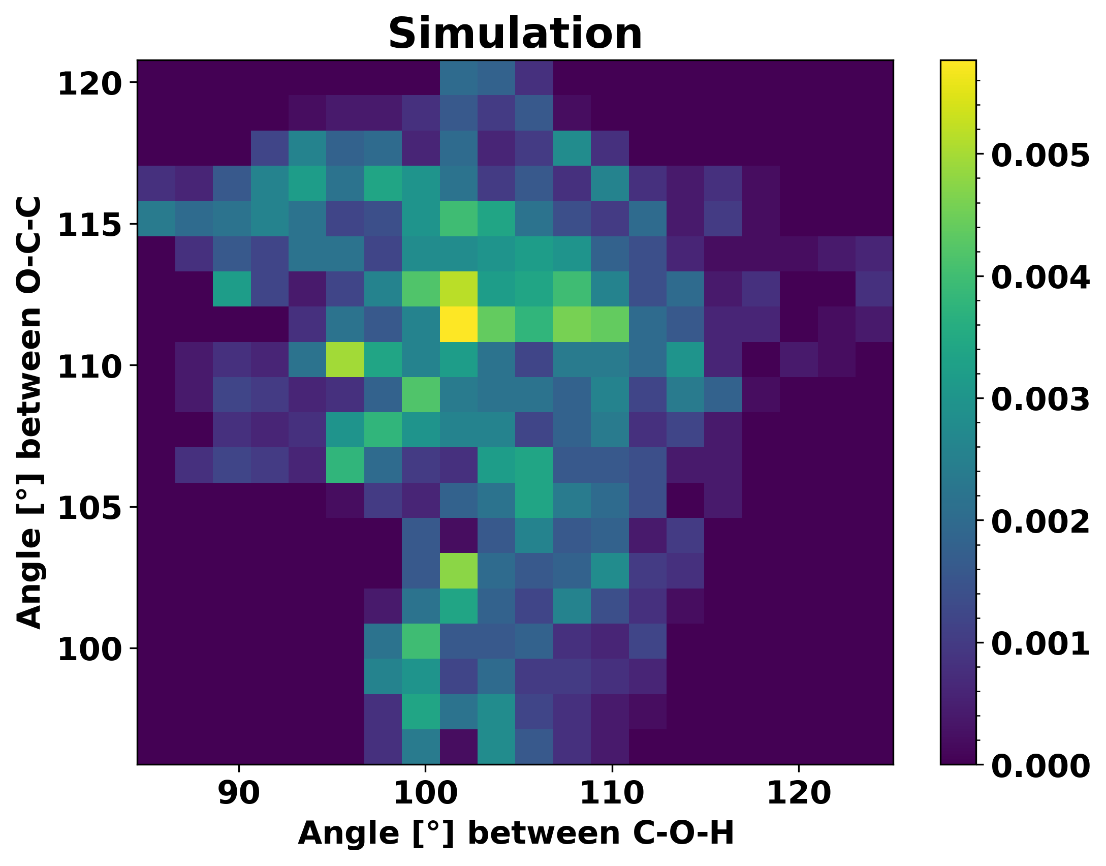
2D histogram

Slide 8
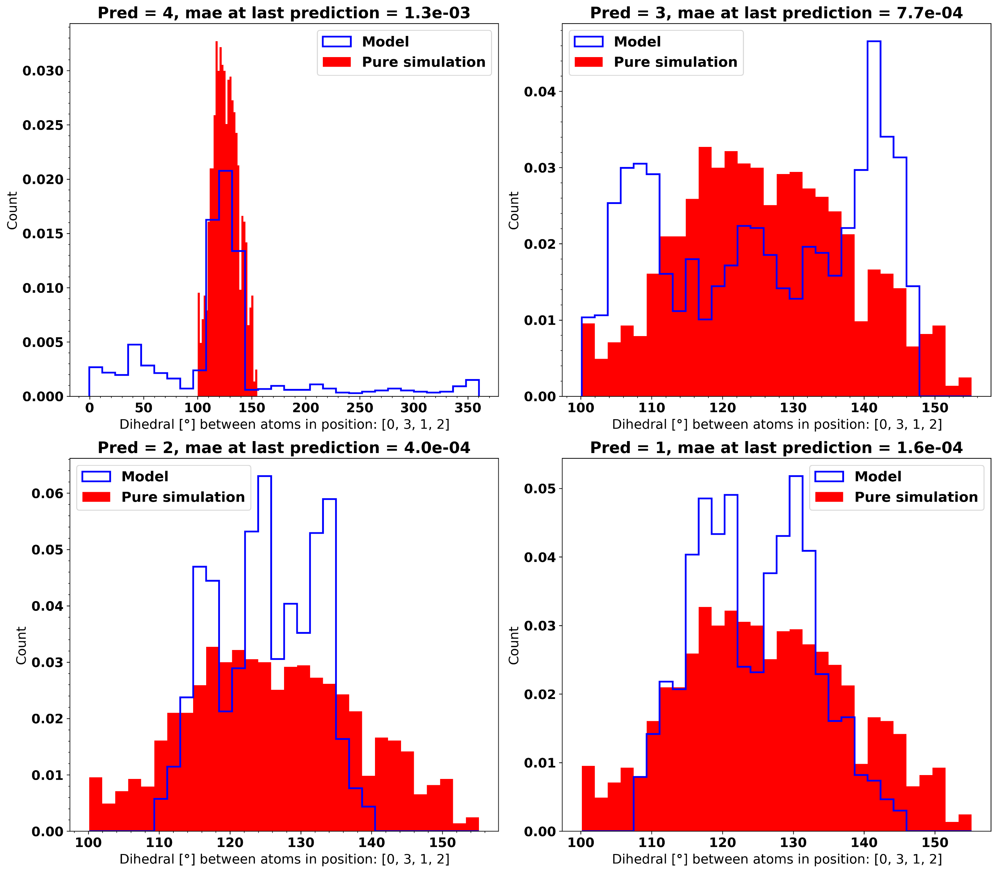
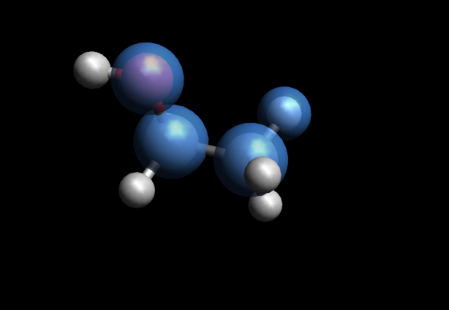
Distribution of Dihedral

Slide 9
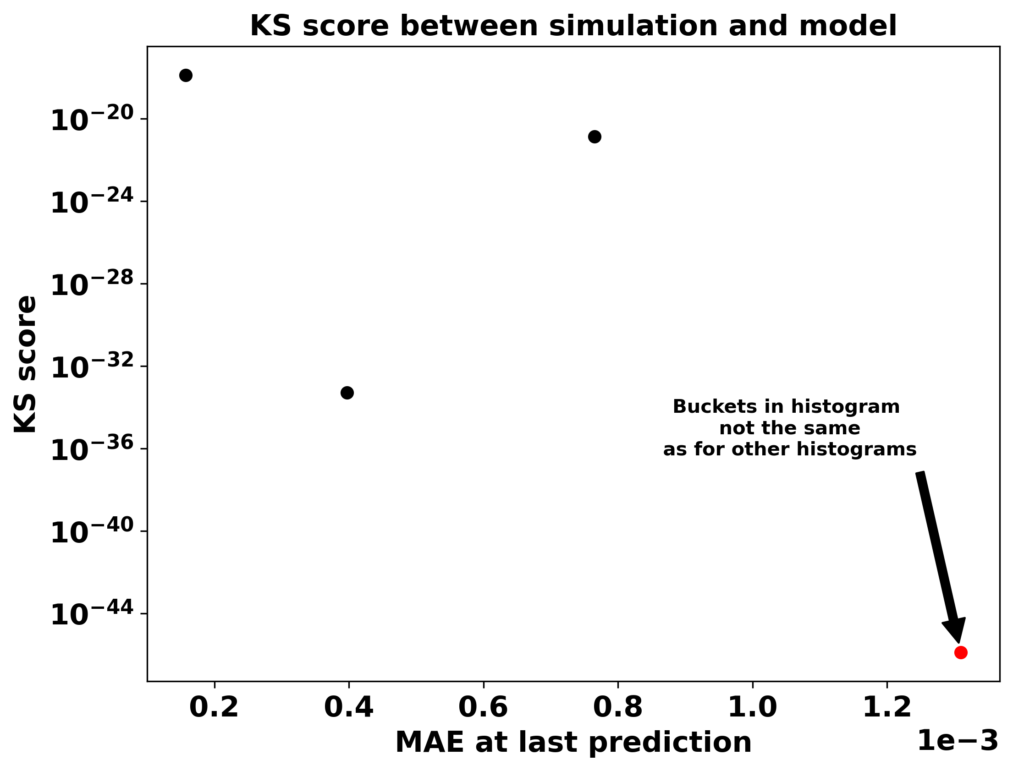
KS score of dihedral comparison

Slide 10
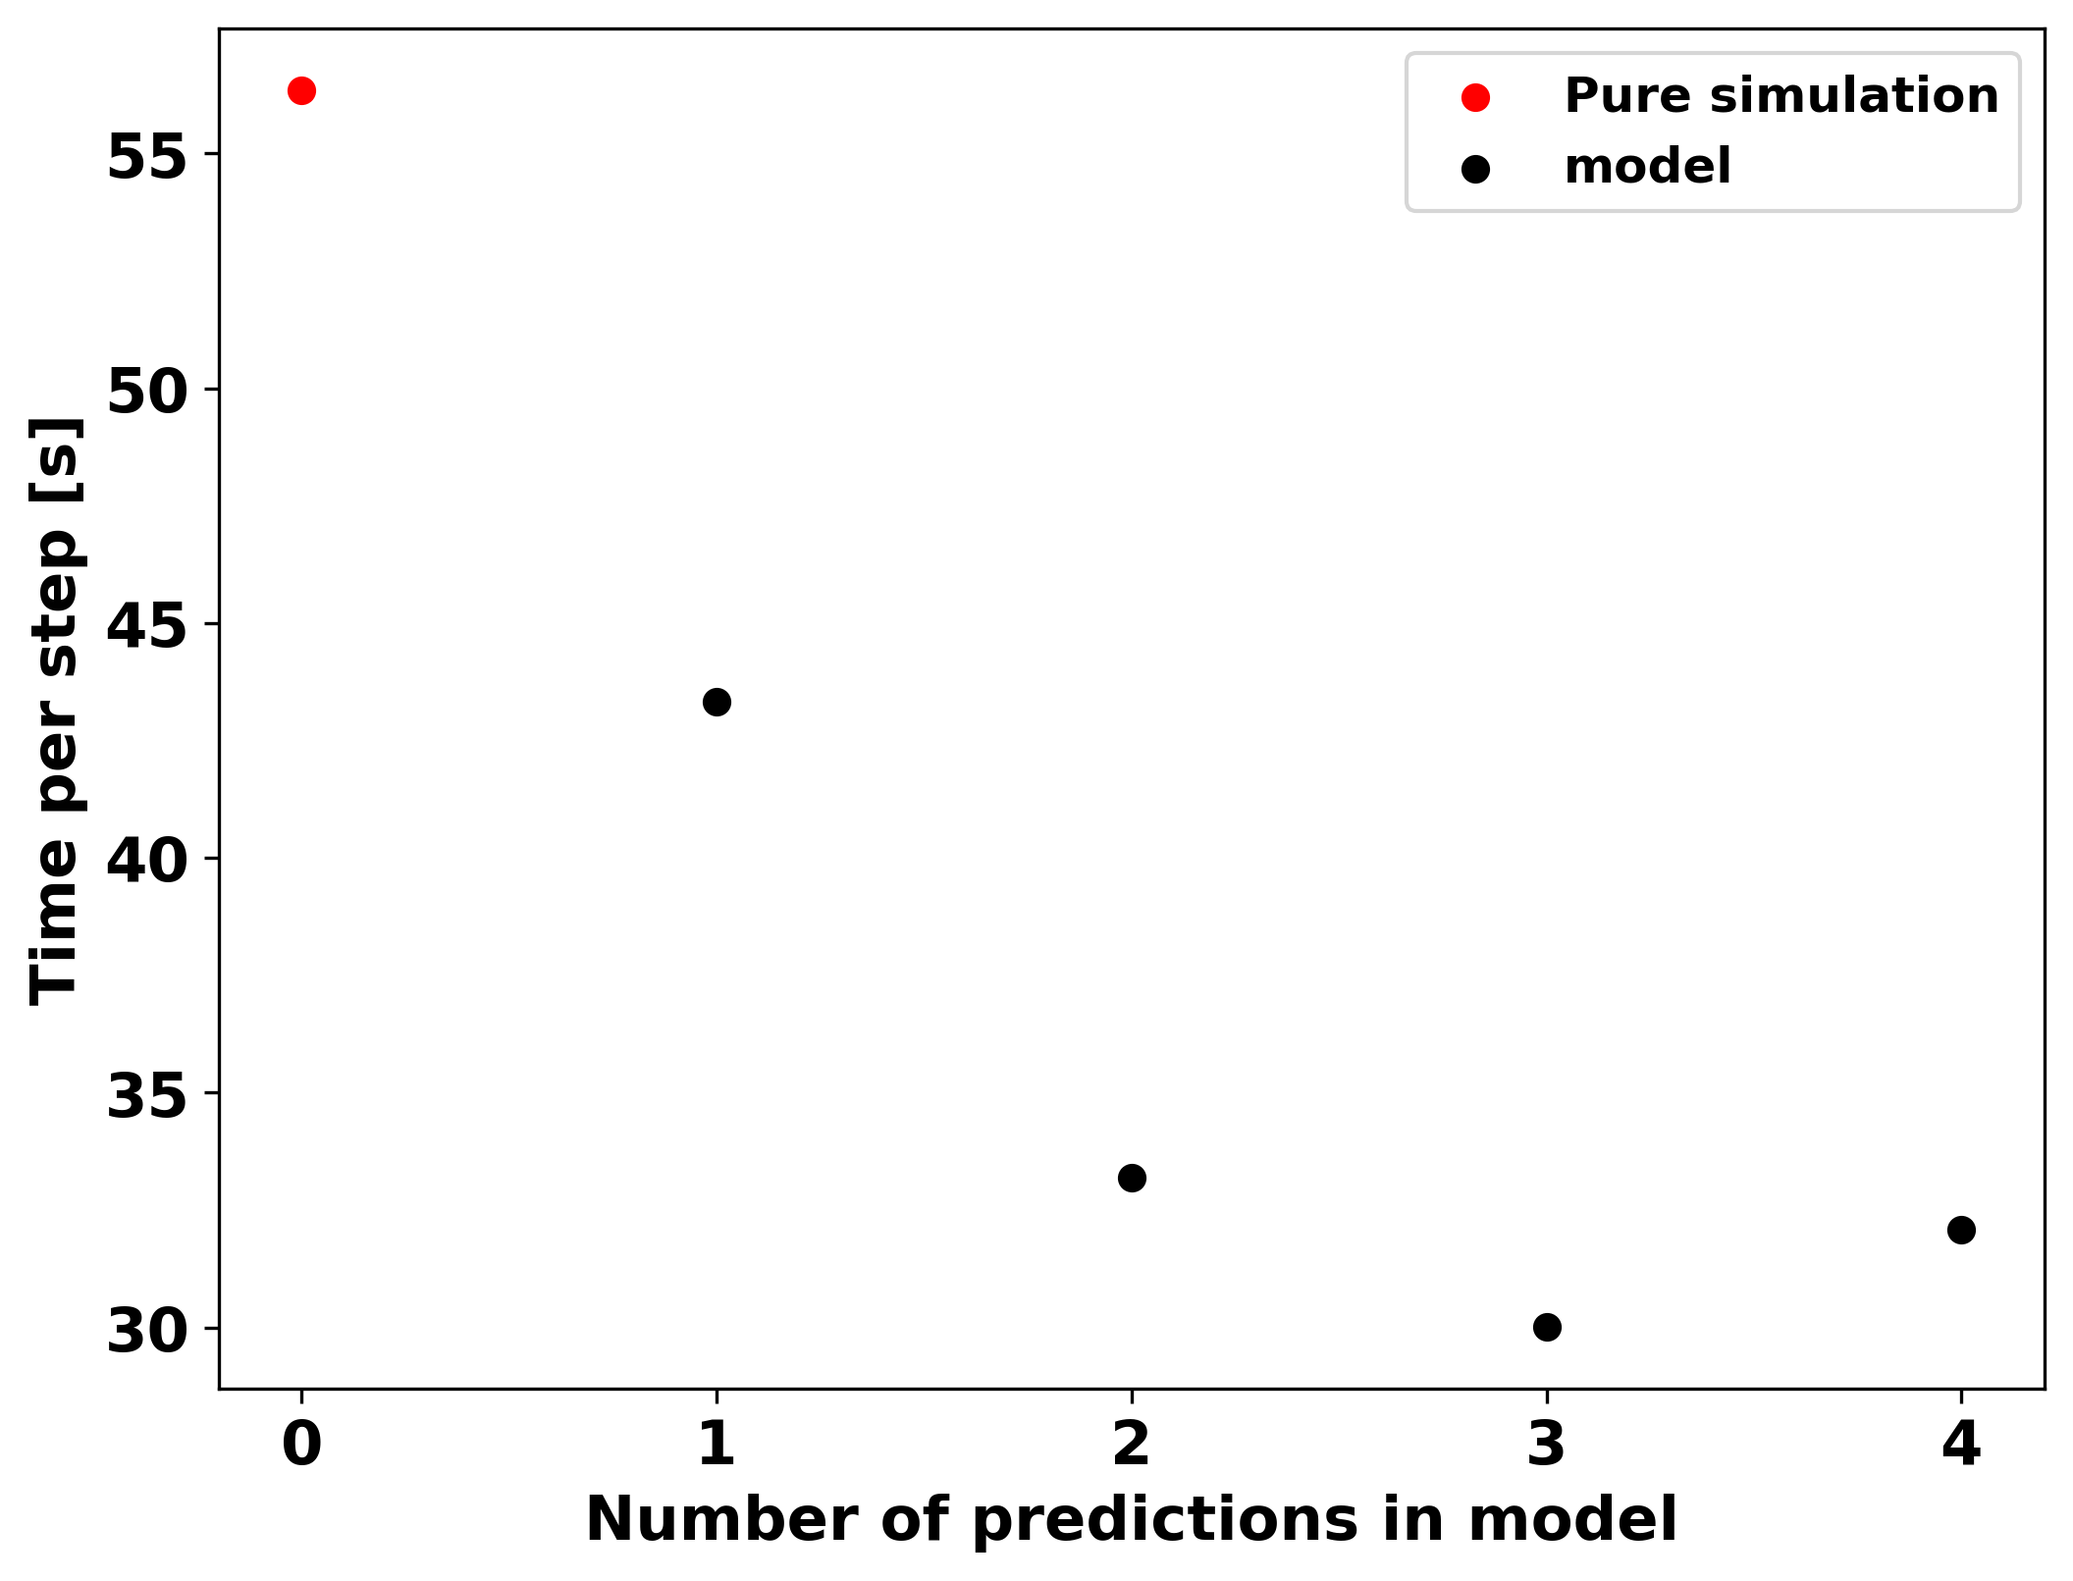
Time spent pr step for each simulation

Slide 11
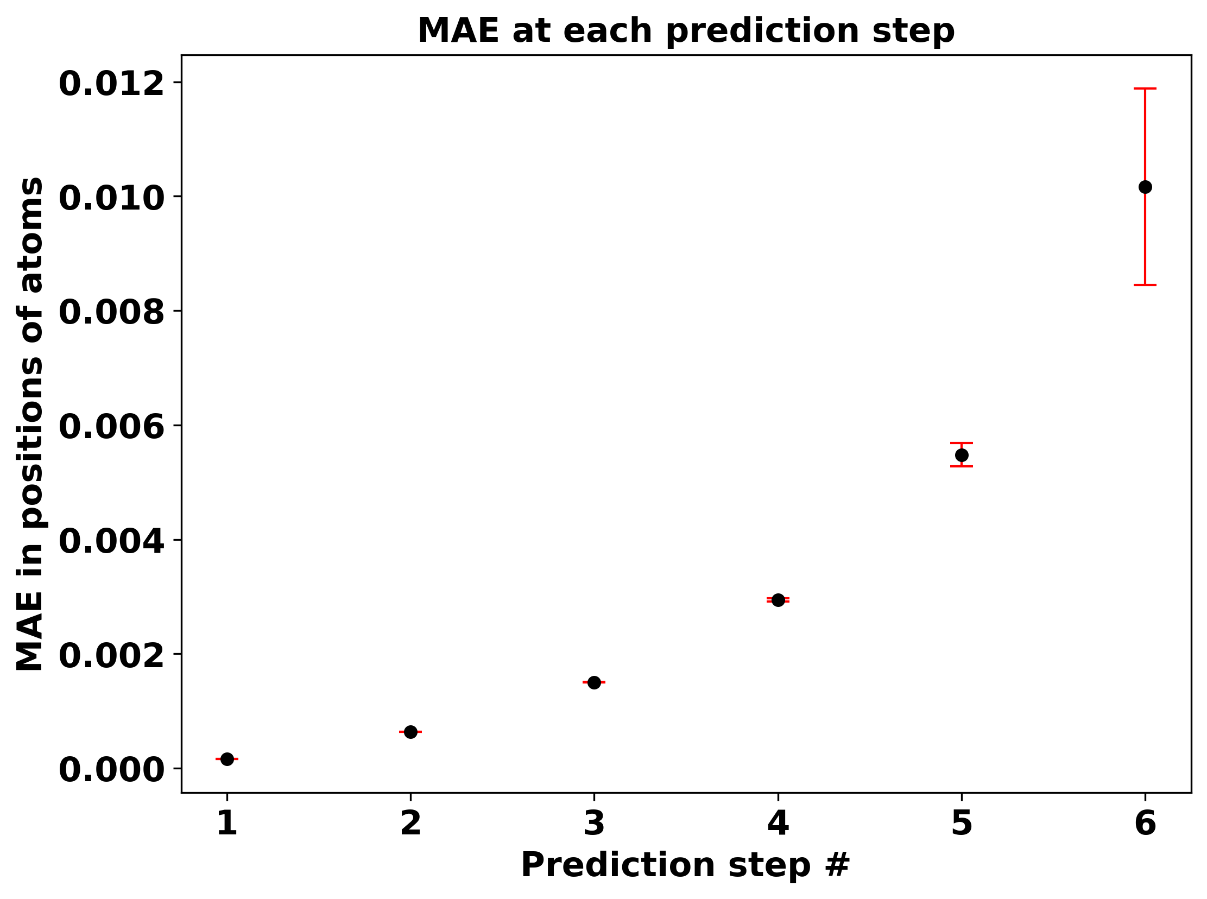
MAE of positions at predicted steps

Slide 12
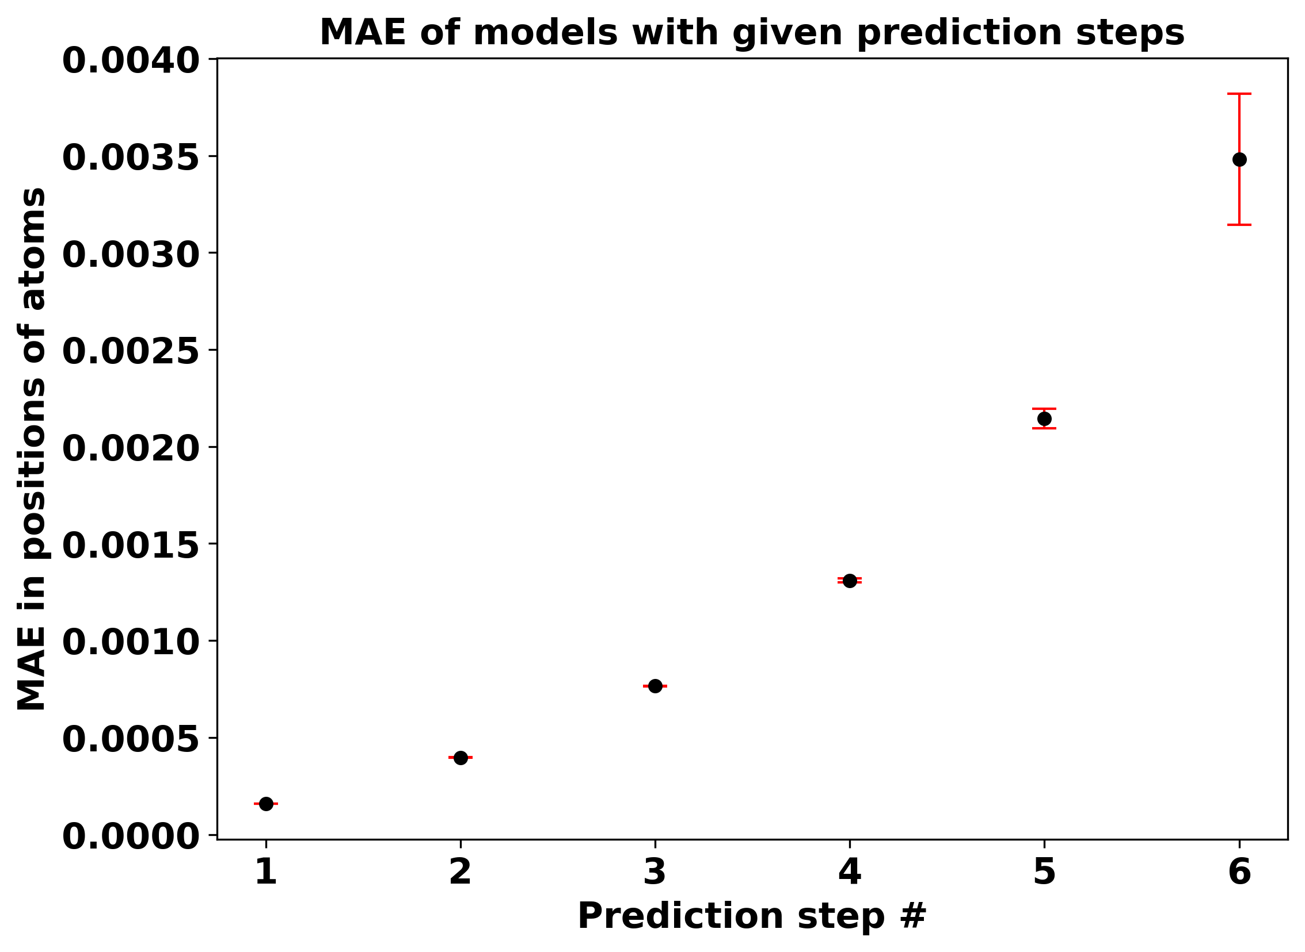
MAE of positions for models with different number of predictions

Slide 13
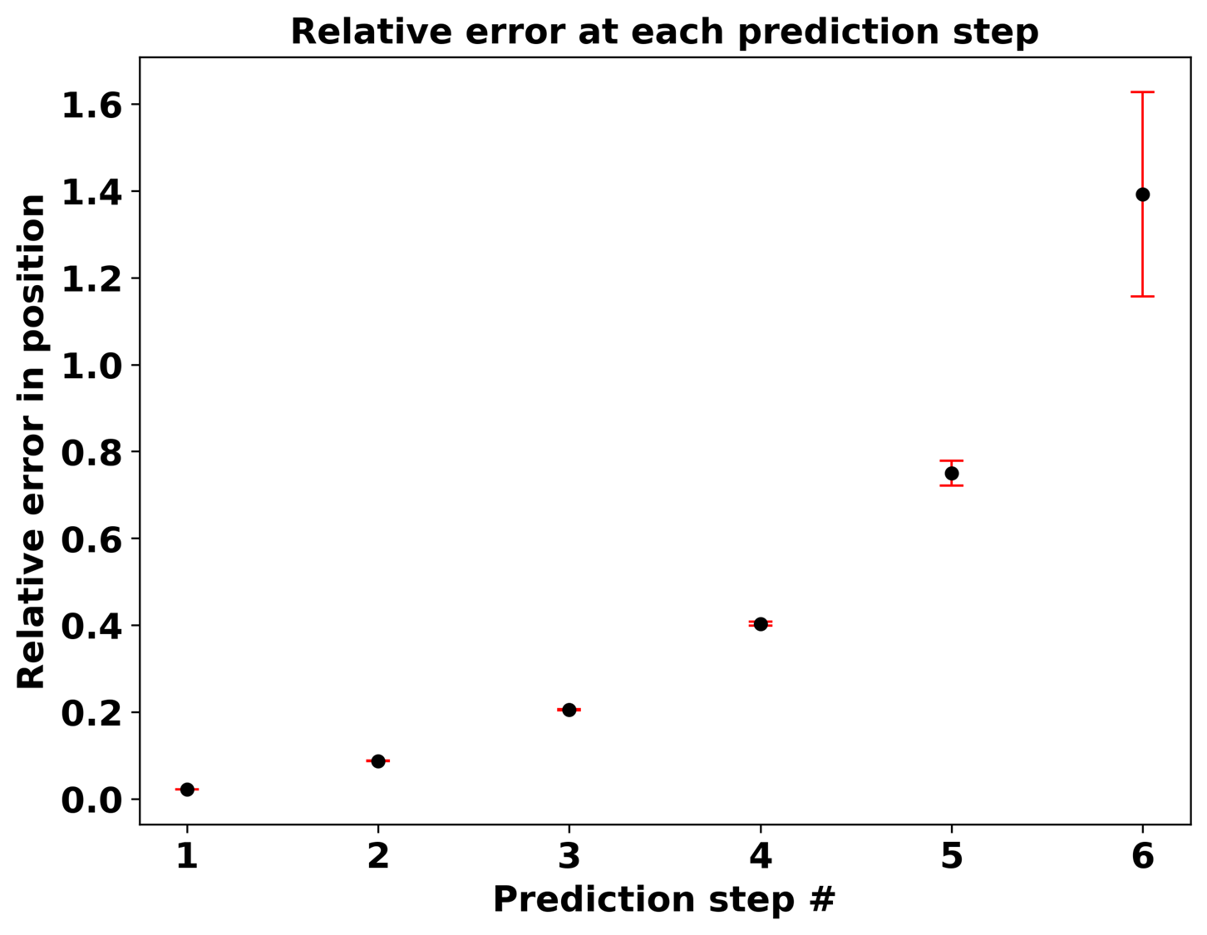
Relative error of positions at predicted steps

Slide 14
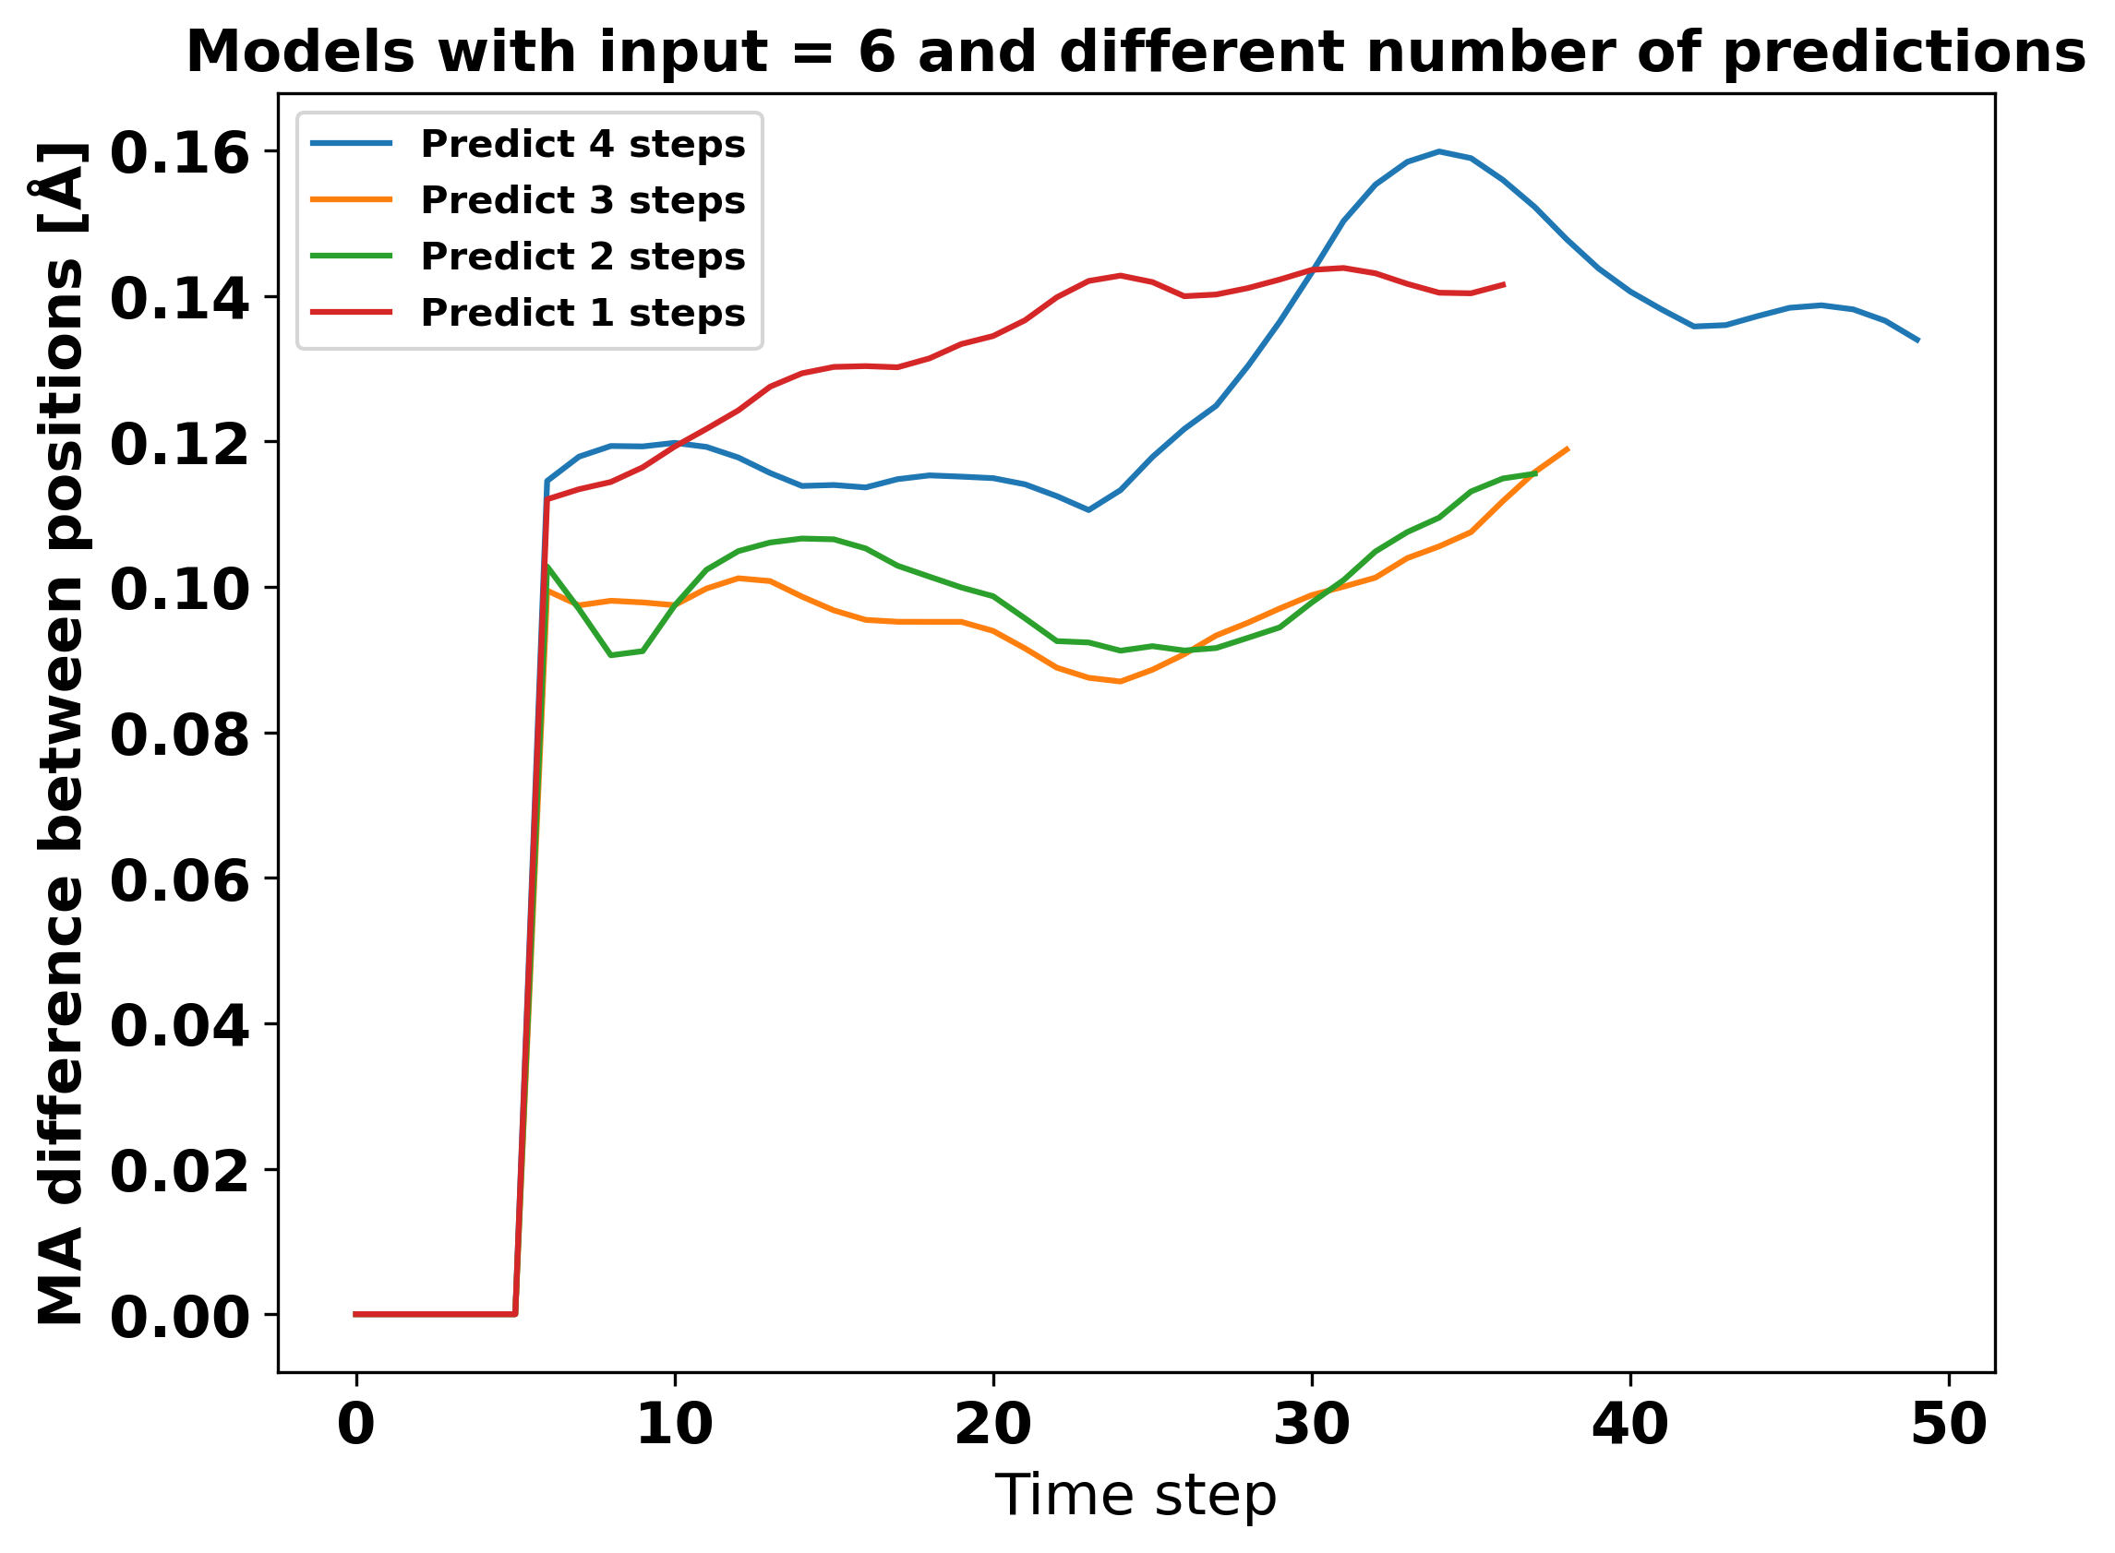

Slide 15
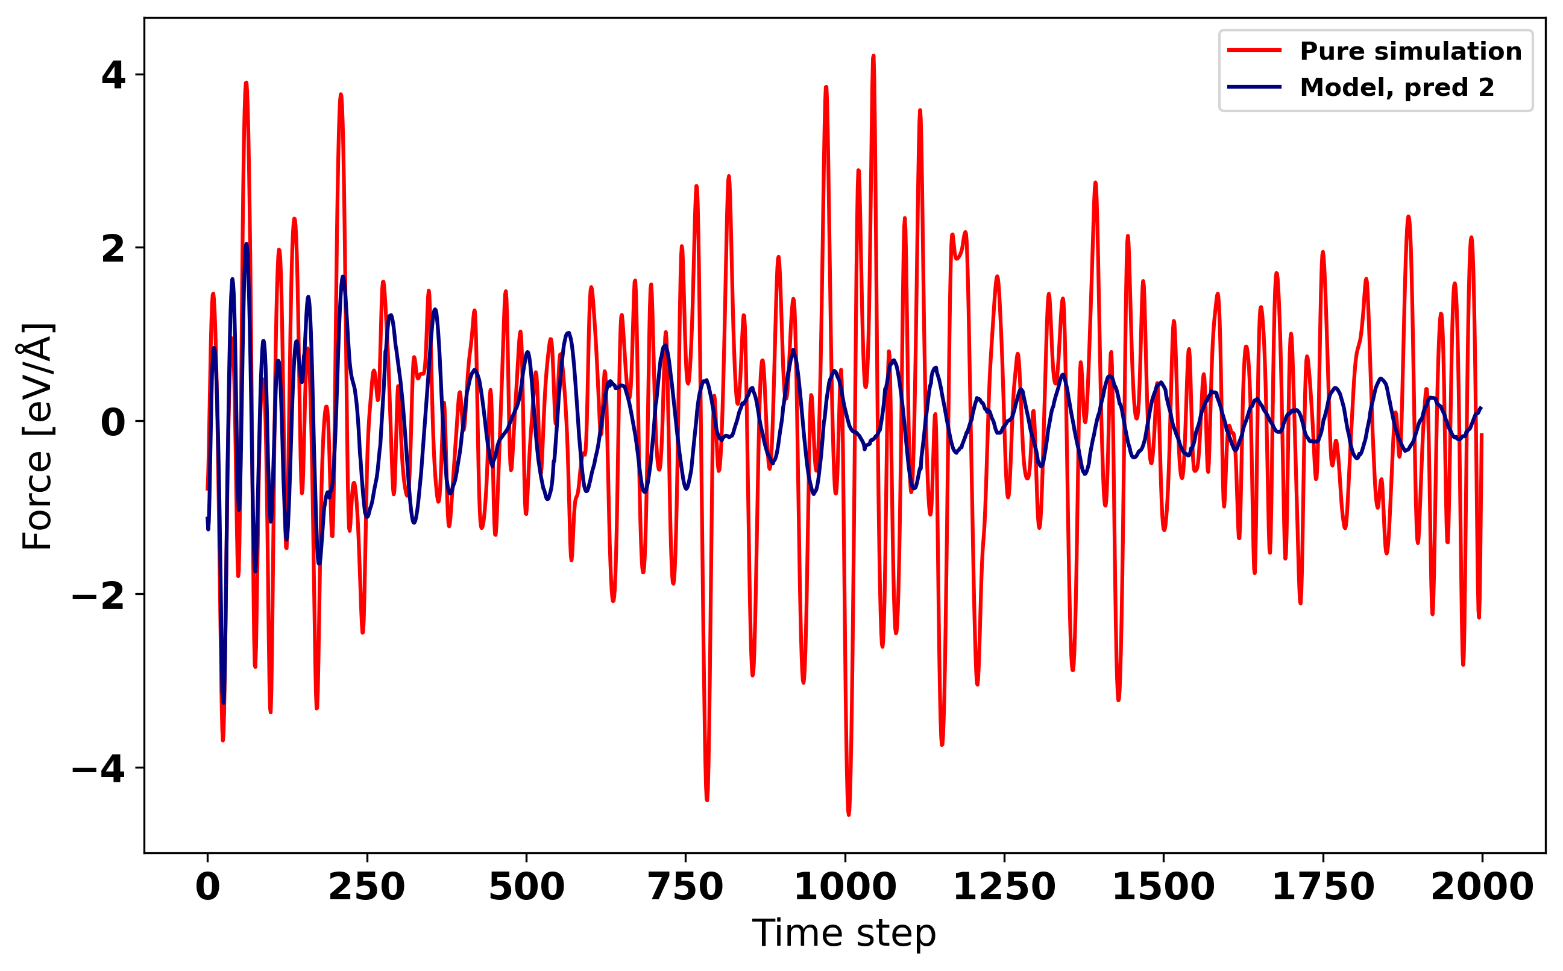
Force trajectory of simulation and model

Slide 16
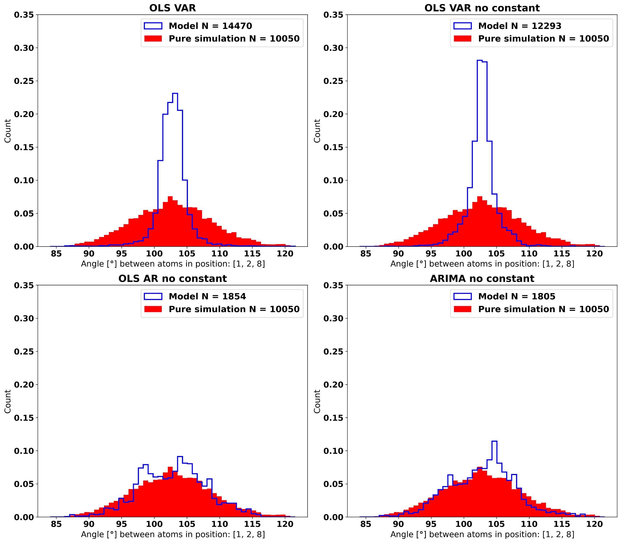
Distribution of angle

